Slide 1
MySQL Course
What to expect

Slide 2
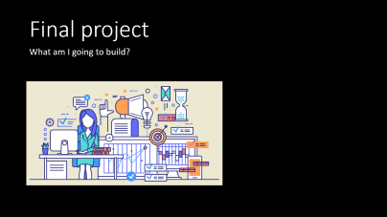

What's coming…

Slide 3

Course content
What am I going to learn?

Slide 4
Overview
The videos:
Integrating Java and MySQL
Perform CRUD operations on a recipe database: Create, Read, Update, Delete
Homework:
Reinforces video learning with Java and MySQL
Final project
Your own database app

Slide 5
Starting out…
Project tools
Working with Maven
Application design
Working with a database
Video Project:
Create a Maven project
Create the layers
Connect to database

Slide 6
Next…
MySQL data types
Video Project: CREATE TABLE statements
Working with relationships
Entity Relationship Diagrams (ERDs)
All about indexes
Video Project: add index statements

Slide 7
And then…
Working with transactions
Video Project: create the tables
Video Project: accept user input
Video Project: bulk insert of data
SQL injection attacks
Video Project: add data to tables

Slide 8
Still more…
Reading data with SELECT
Reading data with JOINs
Using sub-SELECTs
Handling data in application layers
Video Project: list recipes without steps or ingredients
Video Project: select current recipe

Slide 9
Finally…
MySQL functions
Relationships explained
Modifying data
Deleting data
Changing sort order
Video project: all of the above

Slide 10

Final project
What am I going to build?

Slide 11
Final project
You will create your own database application
DIY, project or hobby
Entity Relationship Diagram
One-to-many relationship
Many-to-many relationship
More details to come

Slide 12
A big hint…
If you have kept up with the videos
If you have kept up with the assignments
Then the final project will be easy

Slide 13
A big hint…
If you haven’t kept up with the videos
If you haven’t kept up with the assignments
Then the final project will be hard

Slide 14
Let’s go!
We’ve got a lot to cover in this course
Hang on and stick with it
You’ll be coding with MySQL in no time!

